Slide 1
Loops
Abu saleh musa miah(abid)
Research student, centre for research & innovation (CRI unit-1)
Signal processing & computational neuroscience laboratory.
Dept. Of computer science and engineering (CSE).
Universtiy of rajshahi.

Slide 2
Loops
While
Do..while
For
Exiting from a loop (break,continue, goto)

Slide 3
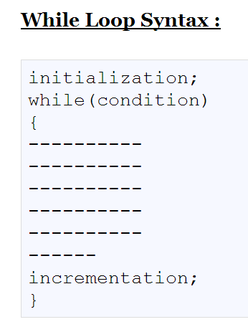
While
A while loop statement in C programming language repeatedly executes a target statement as long as a given condition is true.

Slide 4
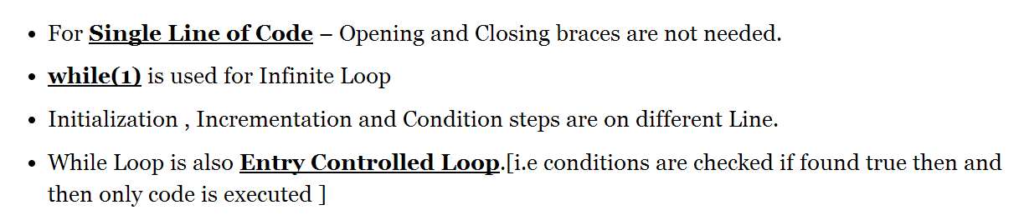
While

Slide 5
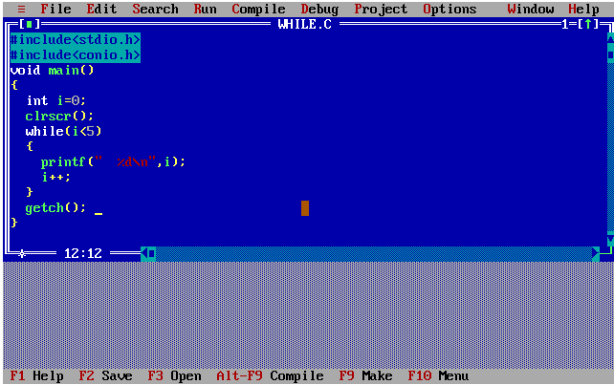
While

Slide 6

While

Slide 7
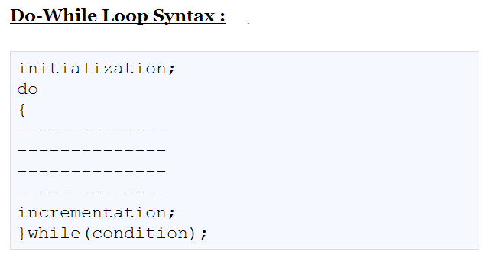
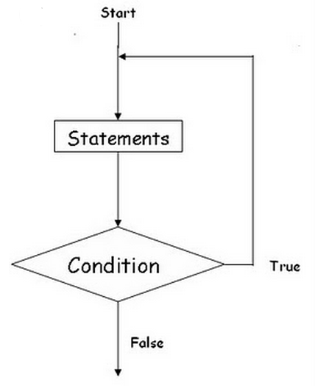
Do…While

Slide 8
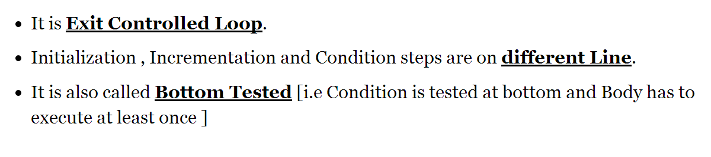
D0…While

Slide 9
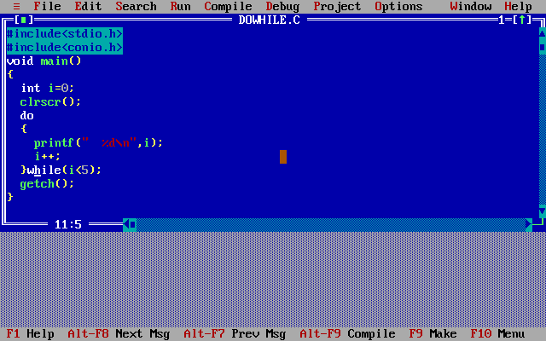
Do…While

Slide 10
Do…While

Slide 11
For Loop
While loop | Do While loop
In While loop the condition is tested first and then the statements are executed if the condition turns out to be true. | A do while is used for a block of code that must be executed at least once. These situations tend to be relatively rare, thus the simple while is more commonly used.
while loop do not run in case the condition given is false. | A do while loop runs at least once even though the the condition given is false
In a while loop the condition is first tested and if it returns true then it goes in the loop | In a do-while loop the condition is tested at the last.
While loop is entry control loop where as do while is exit control loop.
while loop : while (condition) { Statements; } | do while loop : Do { Statements; }while(condition);
while ( choice != 0 ) { System.out.println( "Inside the WHILE loop." ); } | do { System.out.println( "Inside the DO-WHILE loop." ); } while ( choice != 0 );

Slide 12
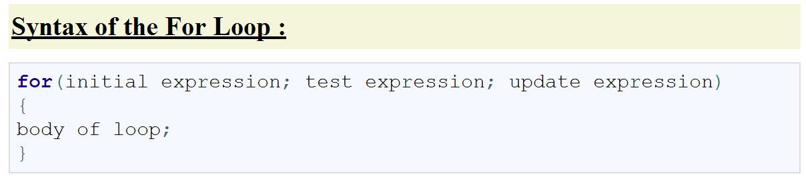
For Loop

Slide 13
For Loop

Slide 14
For Loop
Step 1: first initialization happens and the counter variable gets initialized, here variable is I, which has been assigned by value 1.
Step 2: then condition checks happen, where variable has been tested for a given condition, if the condition results in true then C statements enclosed in loop body gets executed by compiler, otherwise control skips the loop and continue with the next statement following loop.
Step 3: After successful execution of loop’s body, the counter variable is incremented or decremented, depending on the operation (++ or –).
4. The condition is now evaluated again.

Slide 15
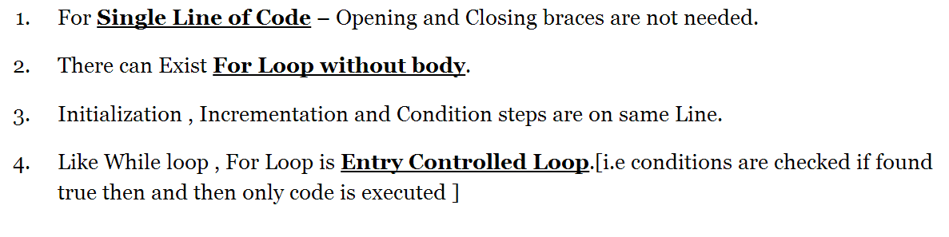
For Loop

Slide 16
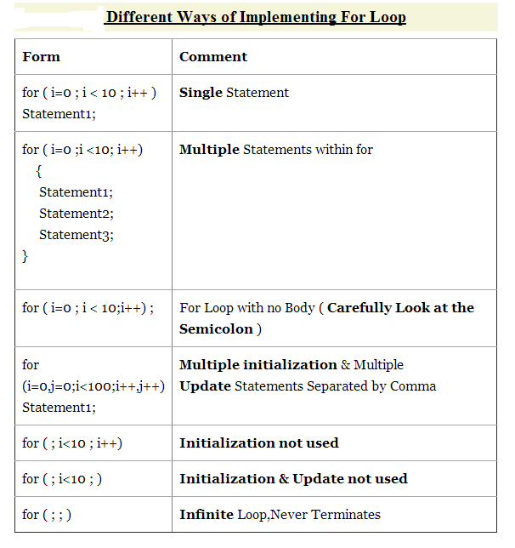
For Loop

Slide 17
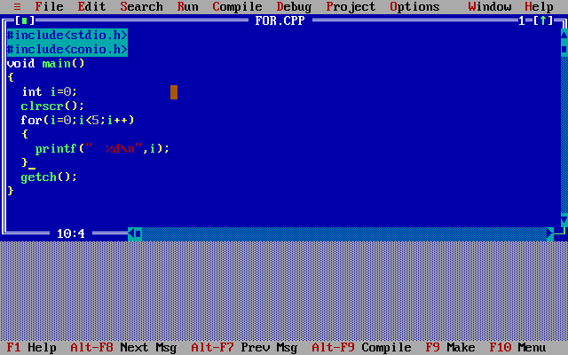
For Loop

Slide 18
For Loop

Slide 19
Sum of series 1 + 2 + …. + n.
int main(){
int n,i;
int sum=0;
printf("Enter the n i.e. max values of series: ");
scanf("%d",&n);
sum = (n * (n + 1)) / 2;
printf("Sum of the series: ");
for(i =1;i <= n;i++){
sum=sum+i; }
printf("%d,",sum);
return 0;
}

Slide 20
Factorial Of A Number
#include<stdio.h>
int main(){
int i,f=1,num;
printf("Enter a number: ");
scanf("%d",&num);
for(i=1;i<=num;i++)
f=f*i;
printf("Factorial of %d is: %d",num,f);
return 0;
}

Slide 21
1 + 1/2 + 1/3 + 1/4 + ... + 1/N
void main() {
float n,sum=0,i;
printf("\n Please Give The Value of N: ");
scanf("%f",&n);
for(i=1;i<=n;i++)
{
sum = sum + (1/i);
if(i==1)
printf("\n 1 +");
elseif(i==n)
printf(" (1/%d) ",i);
else
printf(" (1/%d) + ",i);
}
printf("\n\n THE SUM OF THIS SERIES IS %f",sum);
return 0;
}

Slide 22
Fibonacci Series
int main(){
int k,r;
int i=0,j=1,f;
printf("Enter the number range:");
scanf("%d",&r);
printf("FIBONACCI SERIES: ");
printf("%d %d",i,j); //printing firts two values.
for(k=2;k<r;k++){
f=i+j;
i=j;
j=f;
printf(" %d",j);
}
return 0;
}

Slide 23
Break Statement
It is an jump instruction and can be used inside the switch and loop statements.
The execution of the break statements causes the control transfer to the statement immediately after the loop.

Slide 24
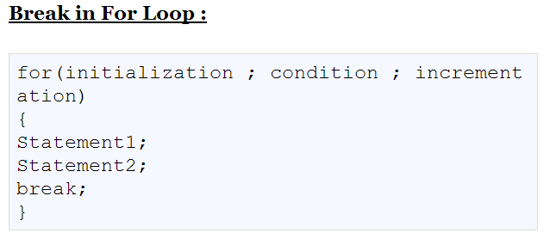
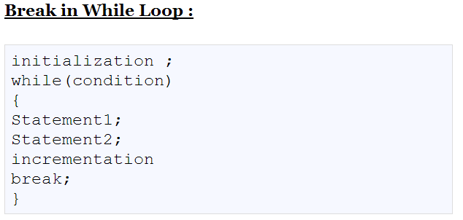
Break Statement

Slide 25
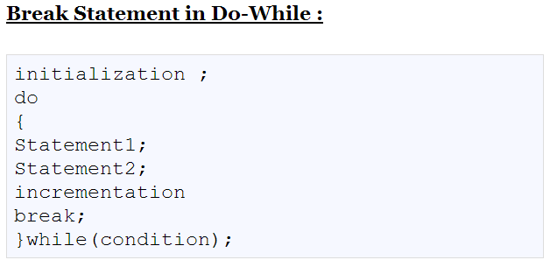
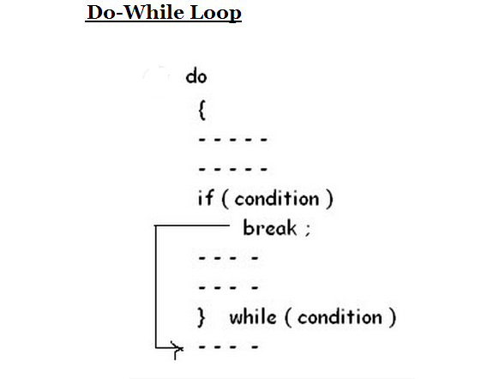
Break Statement

Slide 26
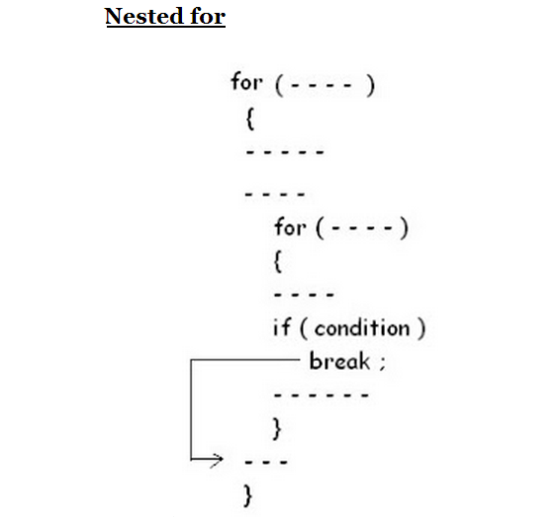
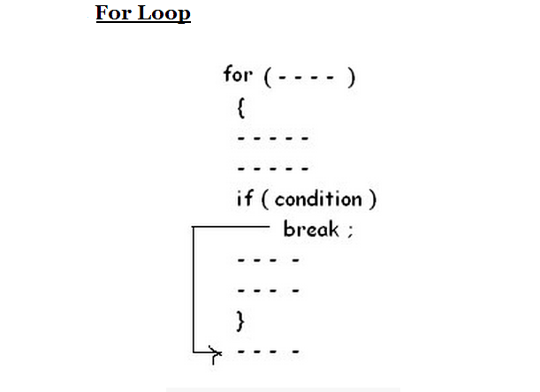
Break Statement

Slide 27
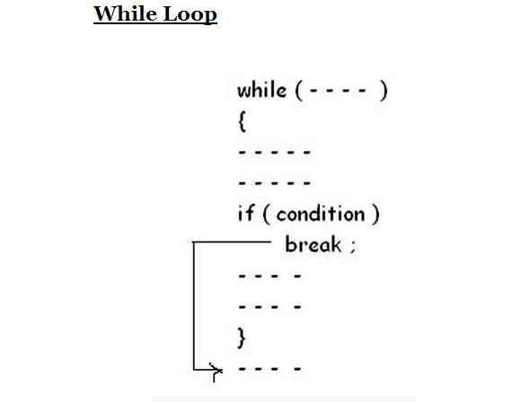
Break Statement

Slide 28
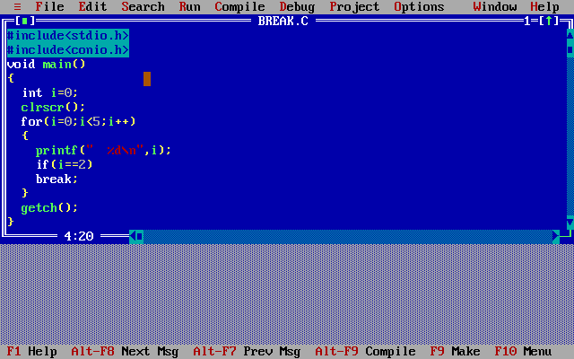
Break Statement

Slide 29

Break Statement

Slide 30
Continue Statement
It is a jump statement.
It is used only inside the loop.
Its execution does not exit from the loop but escape the loop for that iteration and transfer the control back to the loop for the new iteration.

Slide 31
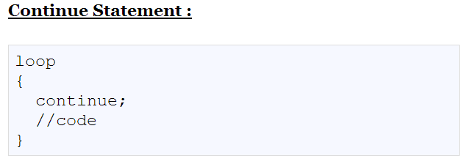
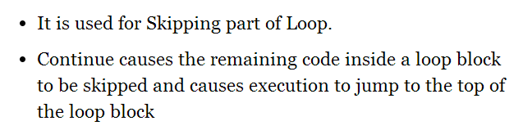
Continue Statement

Slide 32
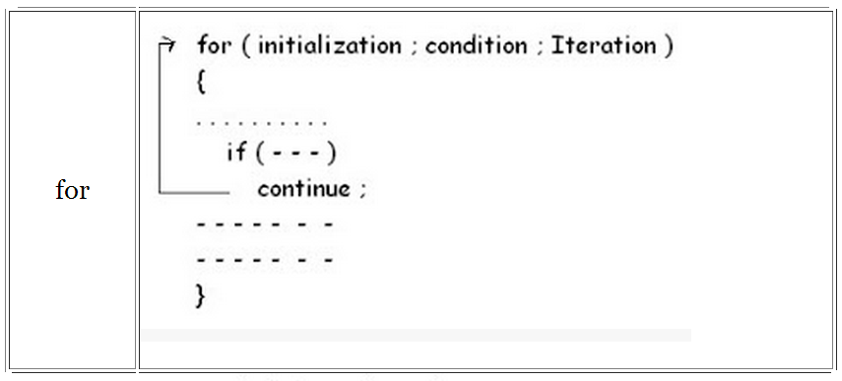
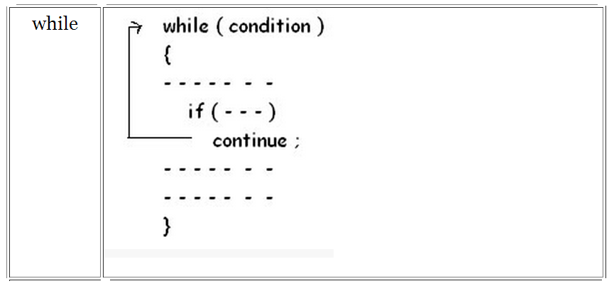
Continue Statement

Slide 33
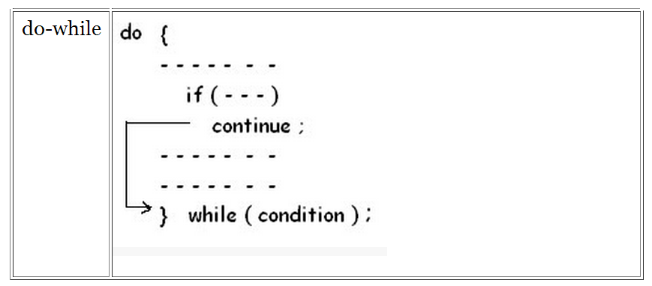
Continue Statement

Slide 34
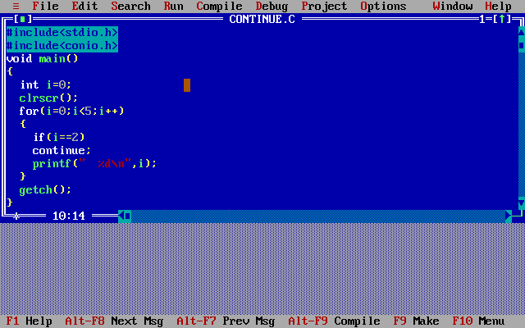
Continue Statement

Slide 35
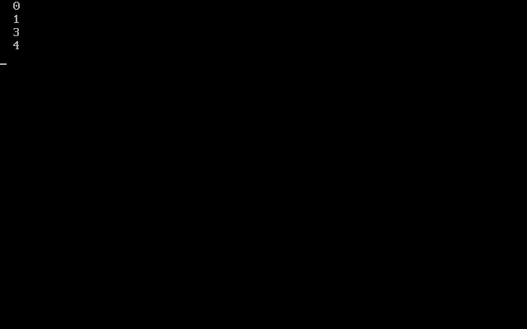
Continue Statement

Slide 36
Goto Statement
break | continue
A break can appear in both switch and 3 loop (for, while, do) statements. | A continue can appear only in 3 loop (for, while, do) statements.
A break causes the switch or loop statements to terminate the moment it is executed. Loop or switch ends abruptly when break is encountered. | A continue doesn't terminate the loop, it causes the loop to go to the next iteration. All iterations of the loop are executed even if continue is encountered. The continue statement is used to skip statements in the loop that appear after the continue.
When a break statement is encountered, it terminates the block and gets the control out of the switch or loop. | When a continue statement is encountered, it gets the control to the next iteration of the loop.

Slide 37
Goto Statement
A break causes the innermost enclosing loop or switch to be exited immediately. | A continue inside a loop nested within a switch causes the next loop iteration
Example break statement using break using while loop and for loop: int counter=10;while (counter >=0){ if (counter==7) { counter--; break; } printf("%d ", counter); counter--;} Output: 10 9 8 Out of while-loop for (int j=0; j<=8; j++){ if (j==4) { Break; } printf("%d ", j);}.. Output: 0 1 2 3 Out of for loop | Example continue statement using break using while loop and for loop: int counter=10;while (counter >=0){ if (counter==7) { counter--; continue; } printf("%d ", counter); counter--;}Output: 10 9 8 6 5 4 3 2 1 0 for (int j=0; j<=8; j++){ if (j==4) { continue; } printf("%d ", j);}..Output:0 1 2 3 5 6 7 8

Slide 38
Goto Statement

Slide 39
*
* * *
* * * * *
* * * * * * *

Slide 40
Goto Statement
It is used the alter the normal sequence of flow by transferring the control to some other part of the program unconditionally.
It is followed by the label statement which determine the instruction to be handled next after the execution of the goto statement.

Slide 41
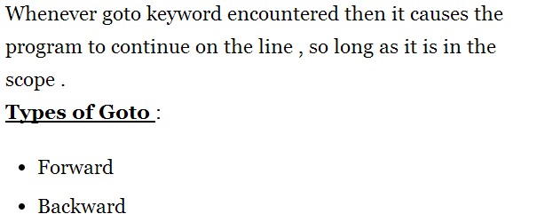
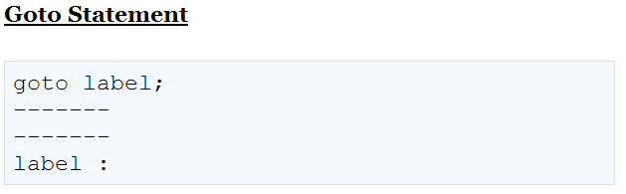
Goto Statement

Slide 42
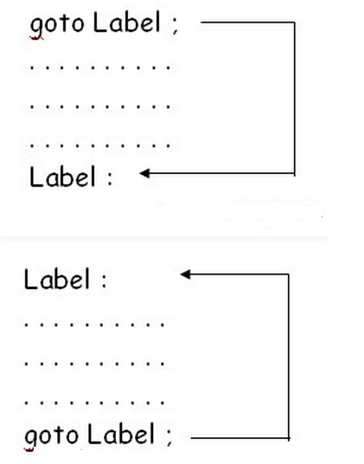
Goto Statement

Slide 43
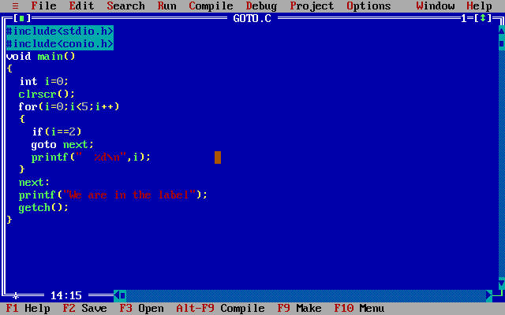
Goto Statement

Slide 44
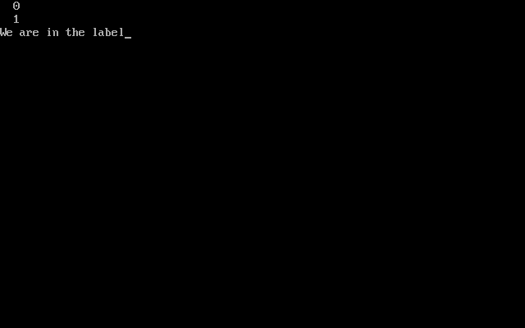
Goto Statement

Slide 45
int main()
{
int i=15,j=10;
printf("hello");
if(i>15)j++;
else{
if(i<15){j--;}
else{
if(j<=10){
i+=++j;
j=i++;
}
else
{
j++;
}
}
if(i>15)
{
i-=--j;
}
else{i+=j;
}
}
printf("i=%d\nj=%d\n",++i,j++);
return 0;
}

